Slide 1
OSI Network Layer

Slide 2
Objectives
Identify the role of the Network Layer, as it describes communication from one end device to another end device
Examine the most common Network Layer protocol, Internet Protocol (IP), and its features for providing connectionless and best-effort service
Understand the principles used to guide the division or grouping of devices into networks
Understand the hierarchical addressing of devices and how this allows communication between networks
Understand the fundamentals of routes, next hop addresses and packet forwarding to a destination network

Slide 3
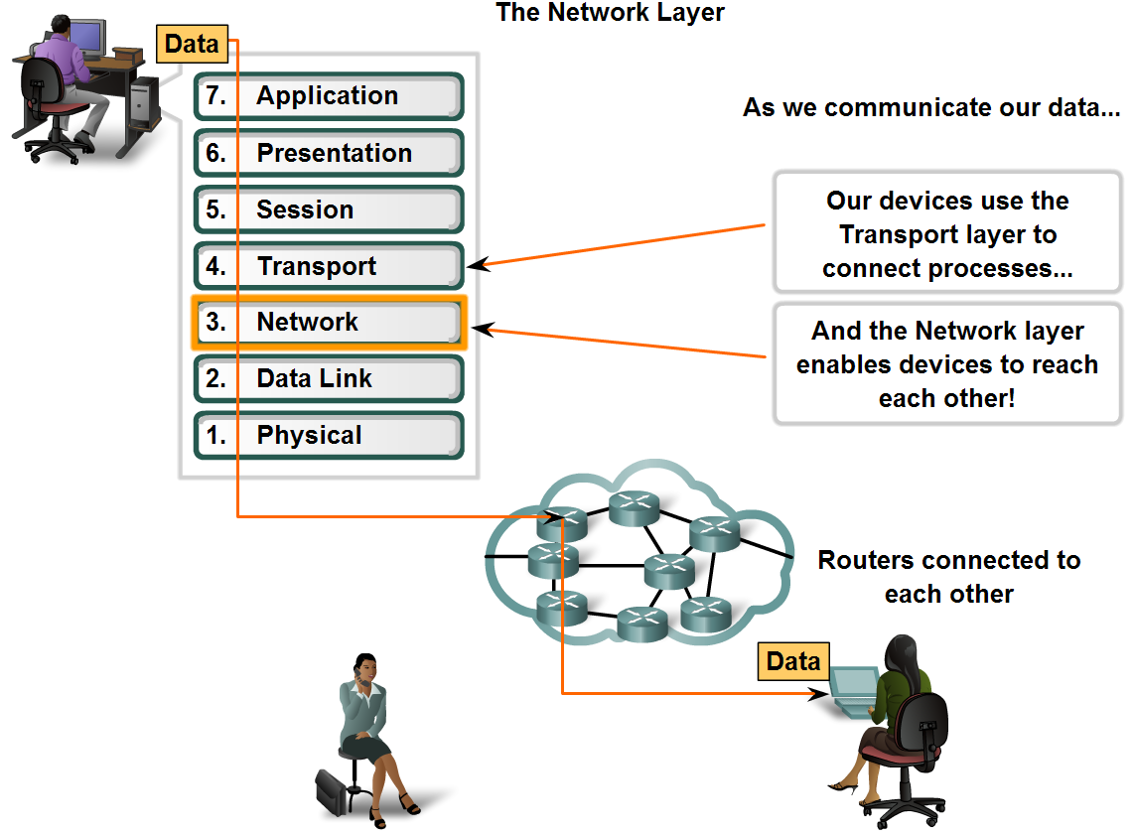
Network Layer Protocols

Slide 4
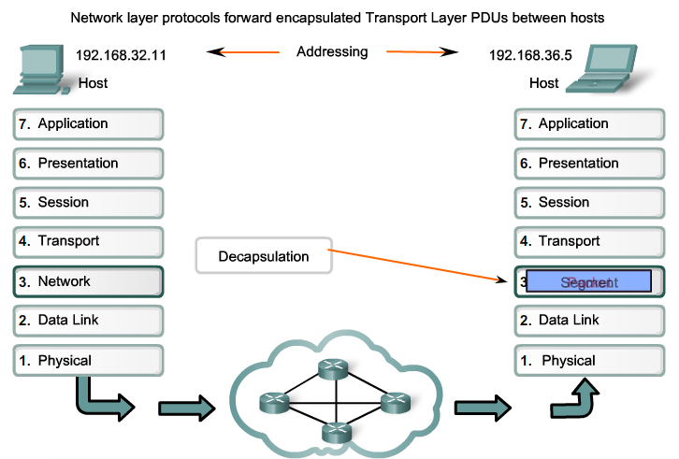
Network Layer Protocols

Slide 5
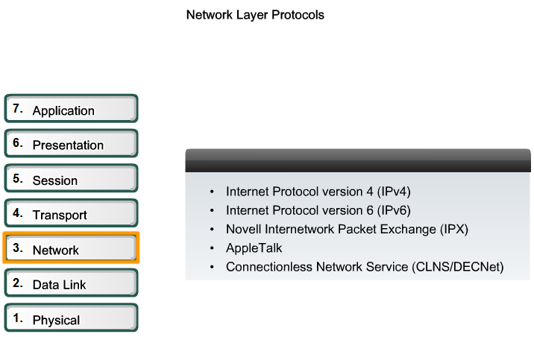
Network Layer Protocols

Slide 6
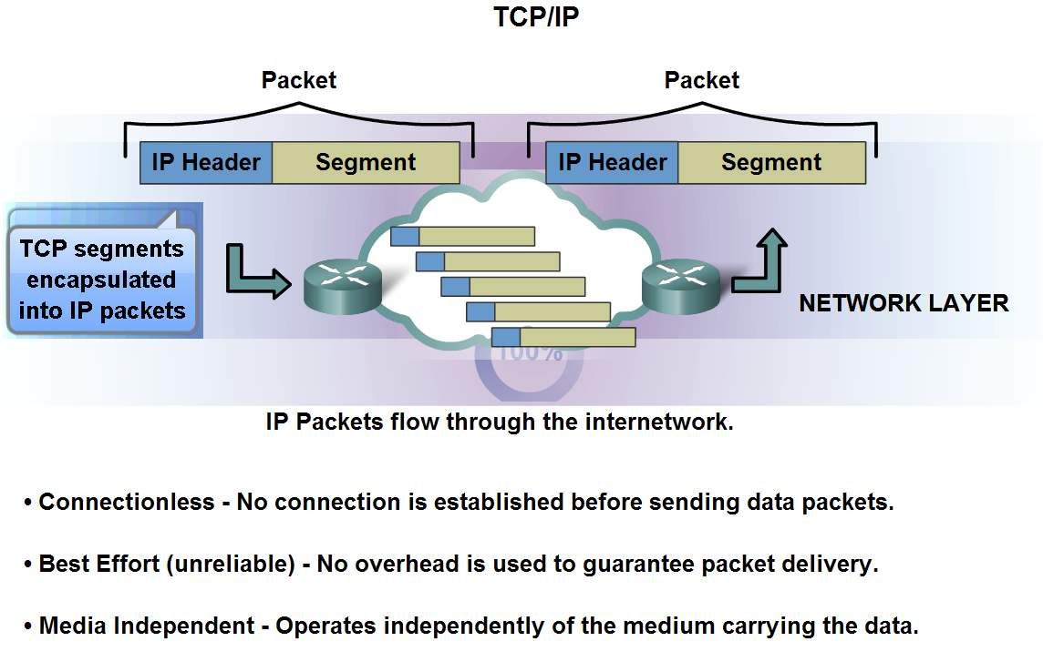
Network Layer Protocols and Internet Protocol (IP)

Slide 7
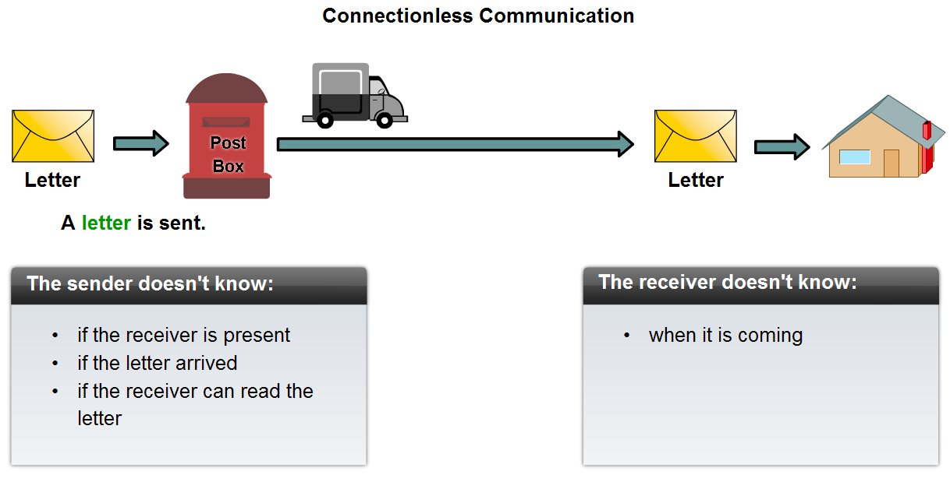
Network Layer Protocols and Internet Protocol (IP)

Slide 8
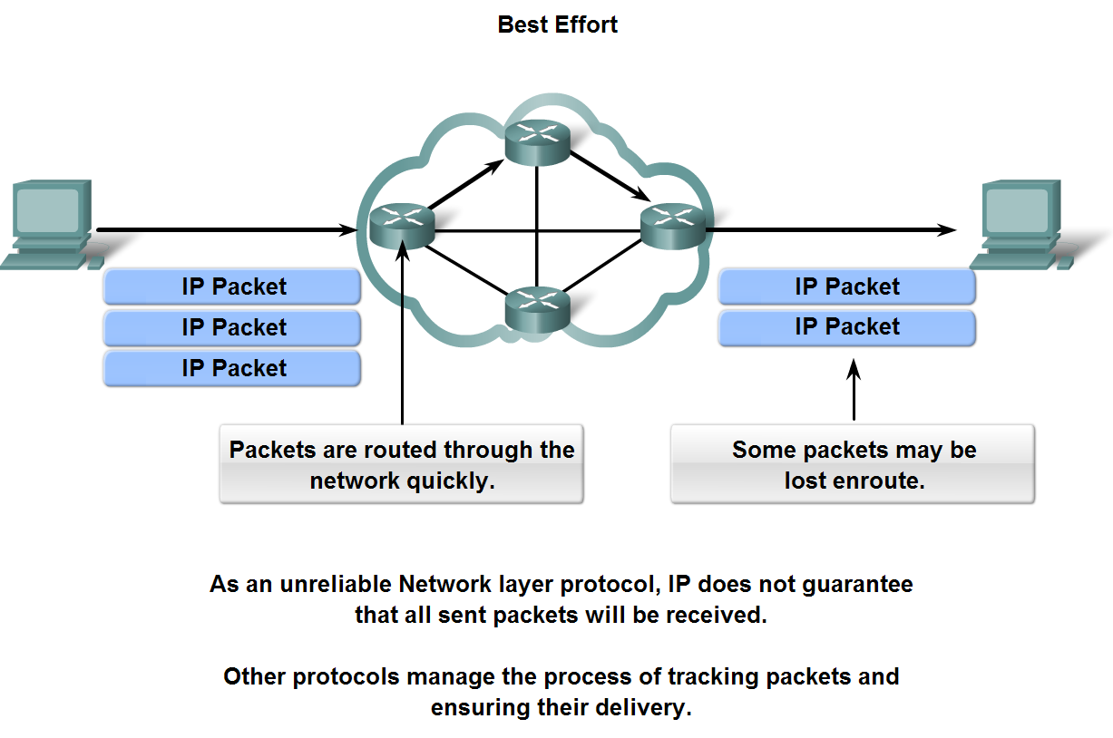
Network Layer Protocols and Internet Protocol (IP)

Slide 9
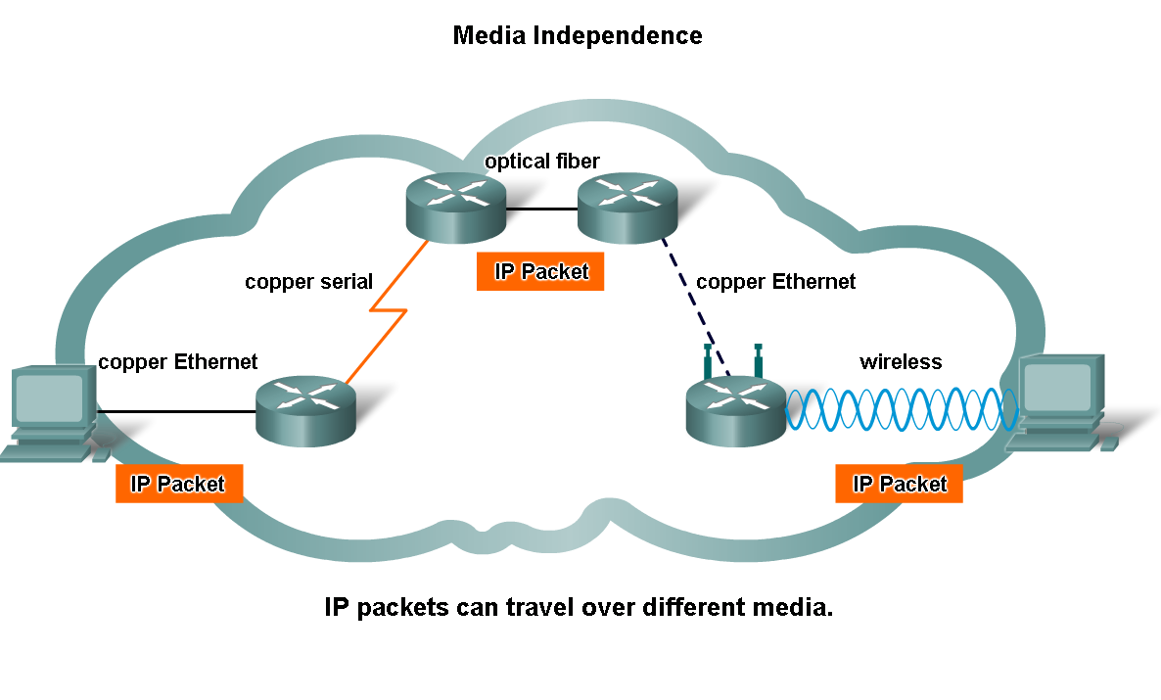
Network Layer Protocols and Internet Protocol (IP)

Slide 10
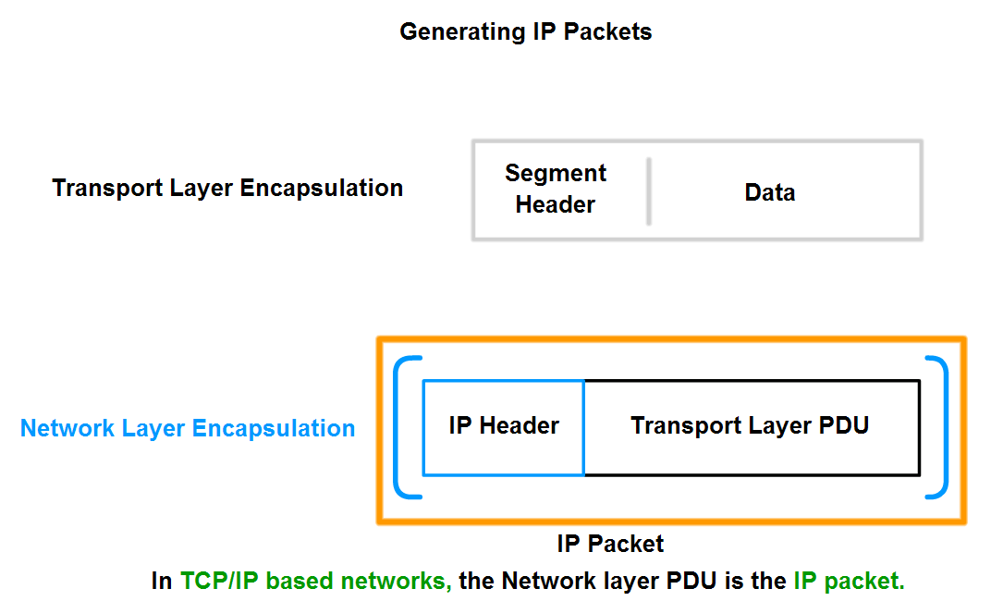
Network Layer Protocols and Internet Protocol (IP)

Slide 11
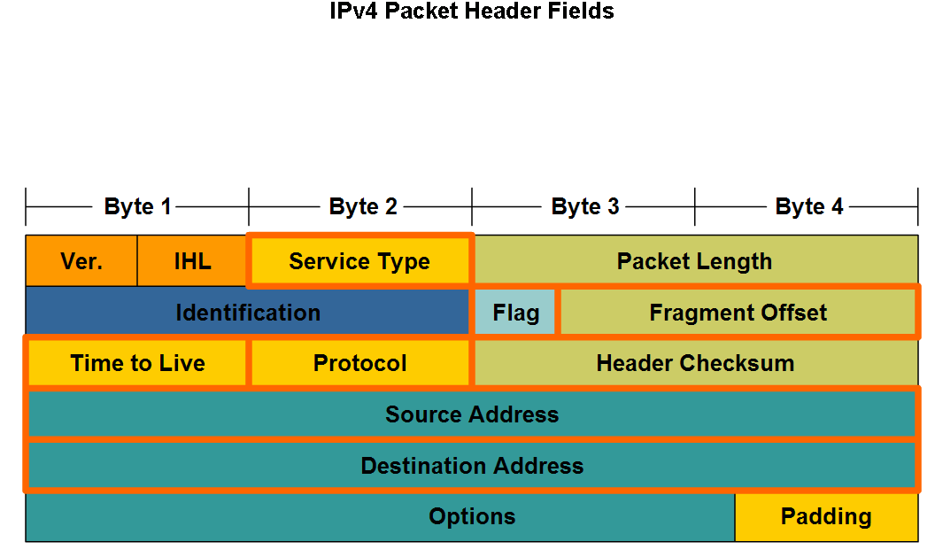
Network Layer Protocols and Internet Protocol (IP)

Slide 12
Traffic Types
Unicast Vs Multicast Vs Broadcast
  Unicast:- One source , One destination
  Multicast:- One source , Many destination
  Broadcast:-One source , All destinations
Routers never forward the Broadcast traffic

Slide 13
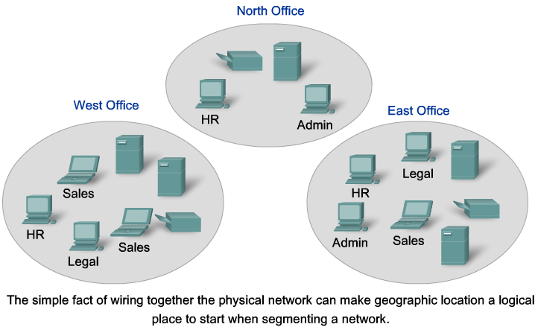
Grouping Devices into Networks and Hierarchical Addressing

Slide 14
Segmentation of networks
Purpose of network segmentation are:-
  Increase Network performance
  Increase Network Security
  Increase Network Management

Slide 15
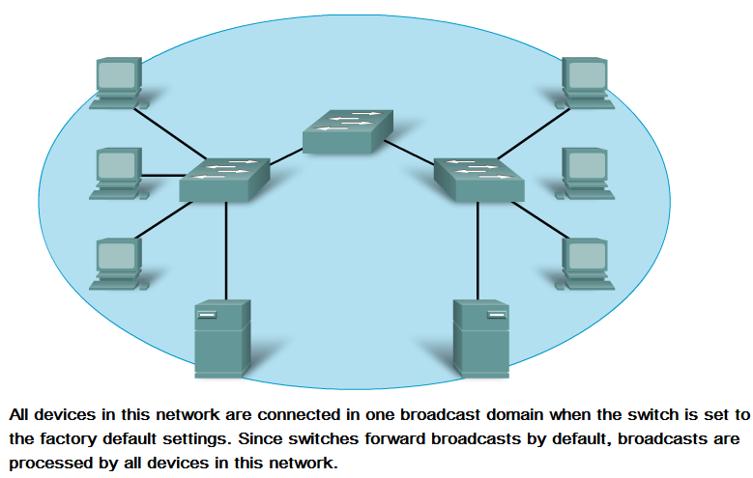
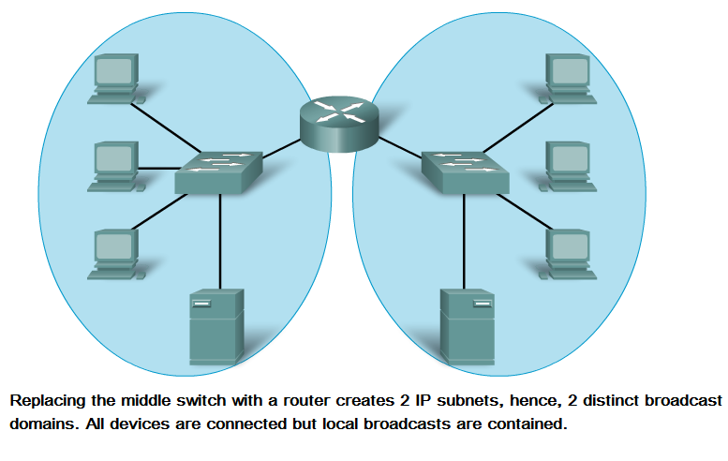
Increase Network performance

Slide 16
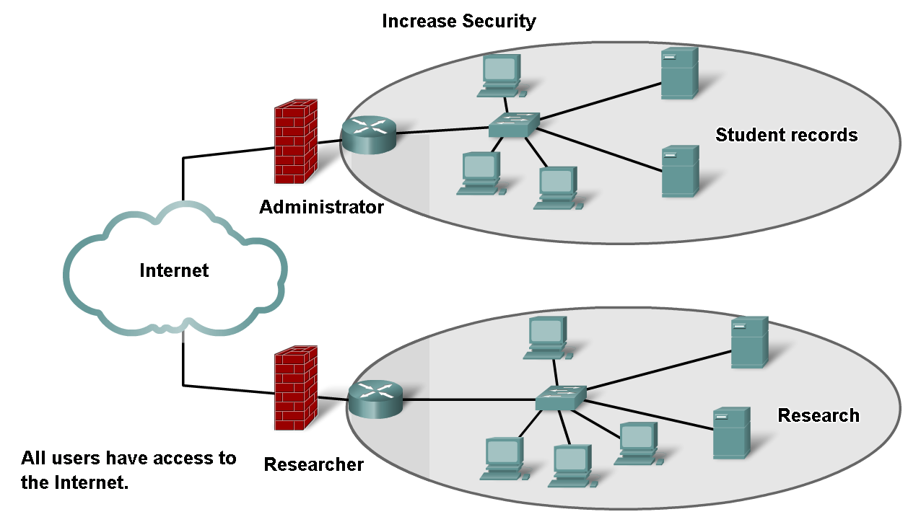
Increase Network Security

Slide 17
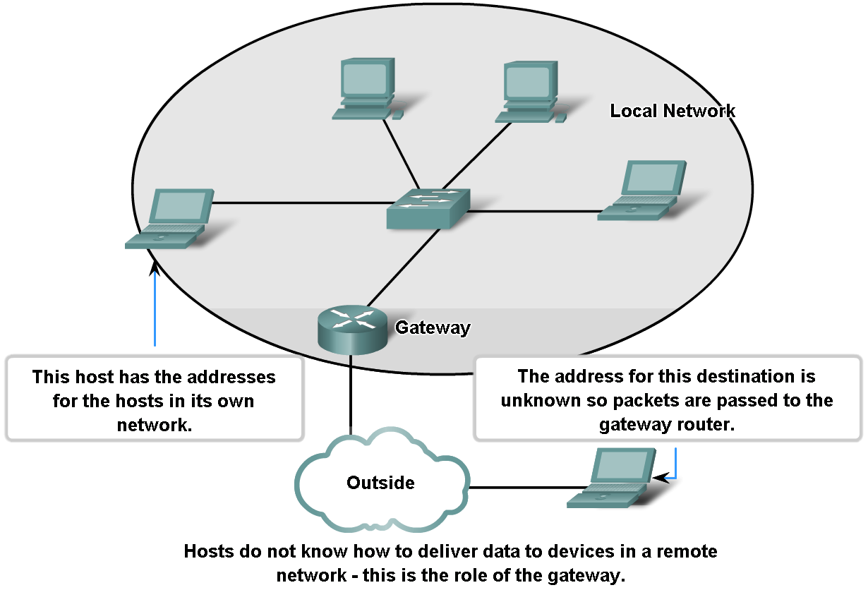
Increase Network manageability

Slide 18
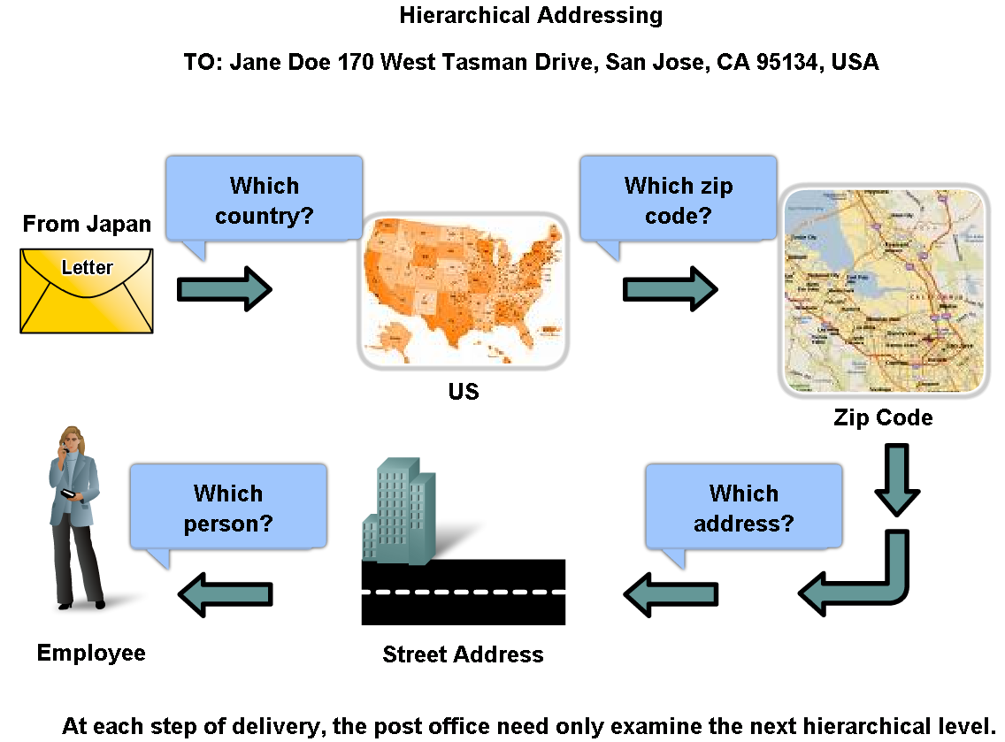
Grouping Devices into Networks and Hierarchical Addressing

Slide 19
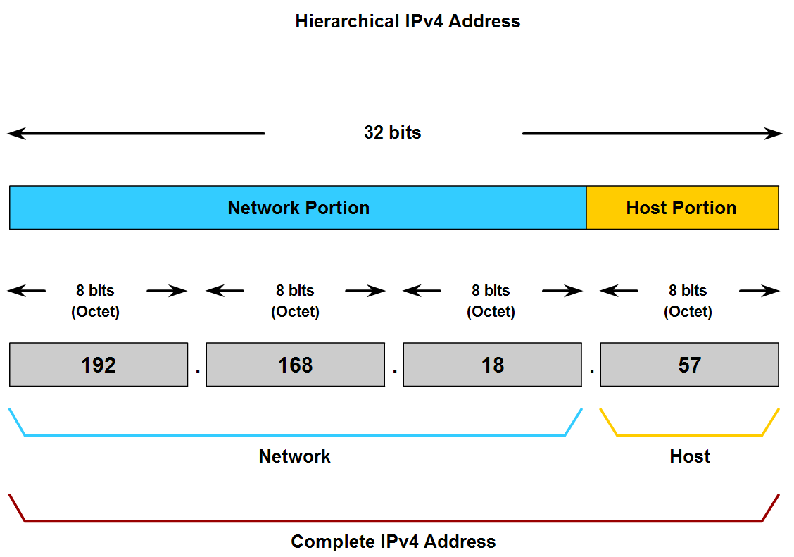
Grouping Devices into Networks and Hierarchical Addressing

Slide 20
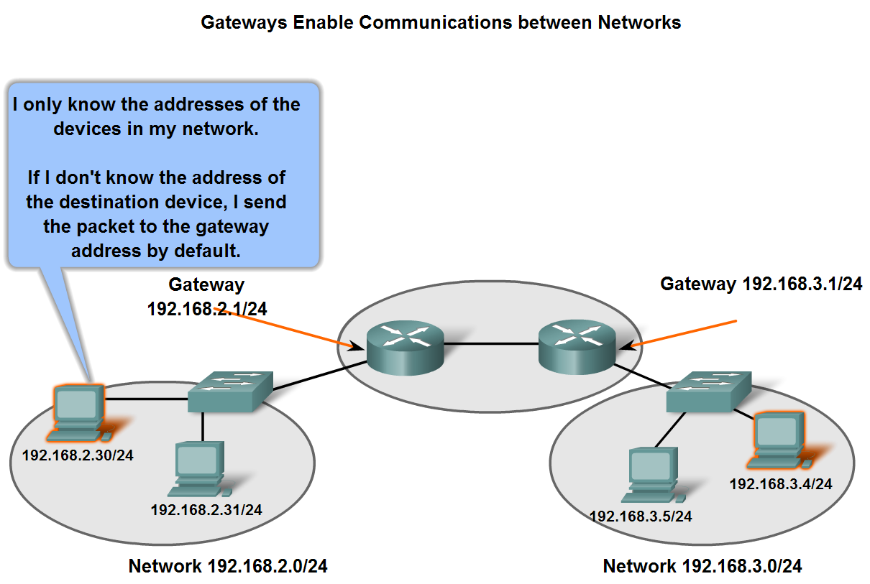
Fundamentals of Routes, Next Hop Addresses and Packet Forwarding

Slide 21
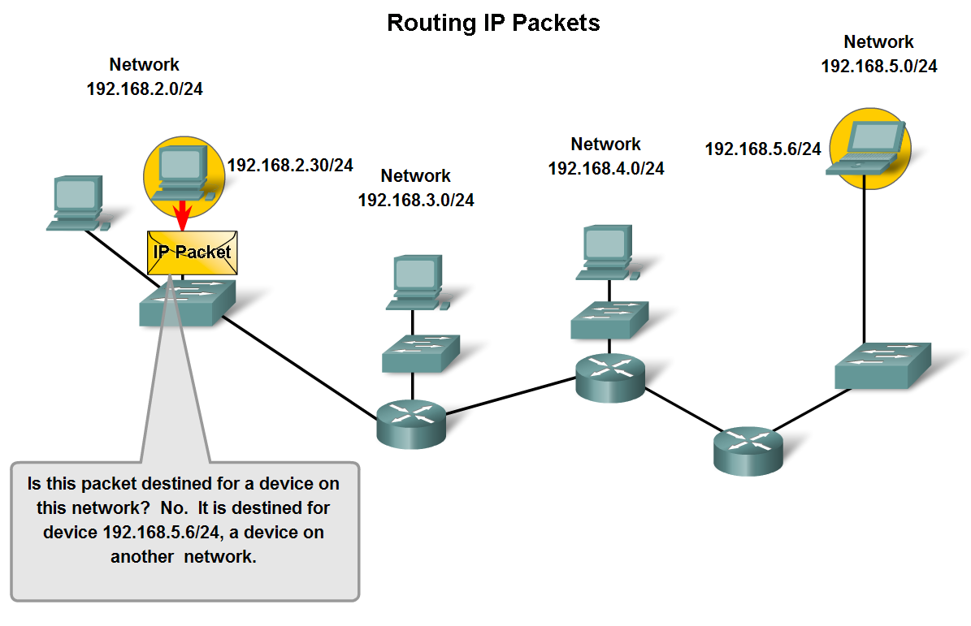
Fundamentals of Routes, Next Hop Addresses and Packet Forwarding

Slide 22
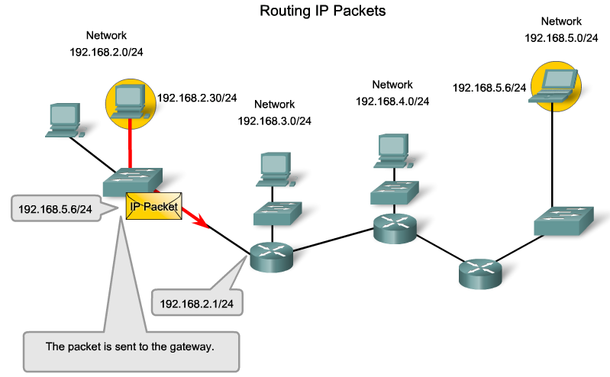
Fundamentals of Routes, Next Hop Addresses and Packet Forwarding

Slide 23
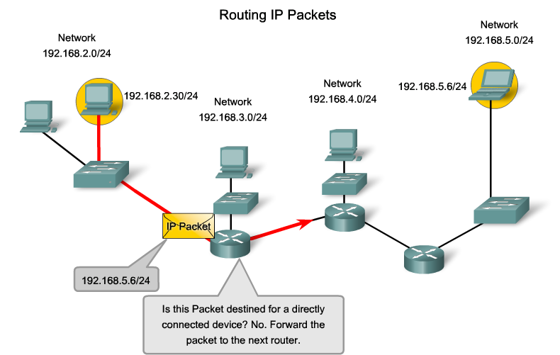
Fundamentals of Routes, Next Hop Addresses and Packet Forwarding

Slide 24
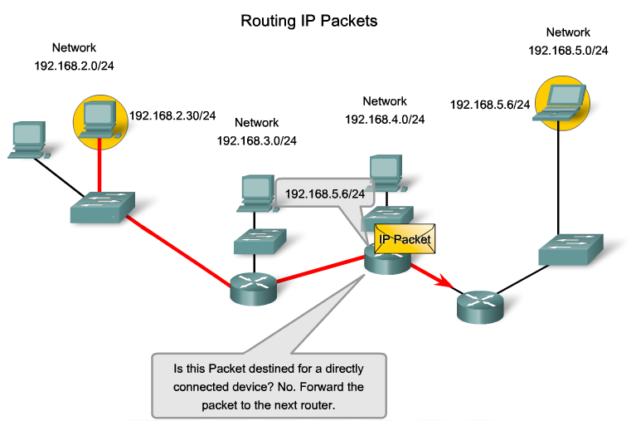
Fundamentals of Routes, Next Hop Addresses and Packet Forwarding

Slide 25
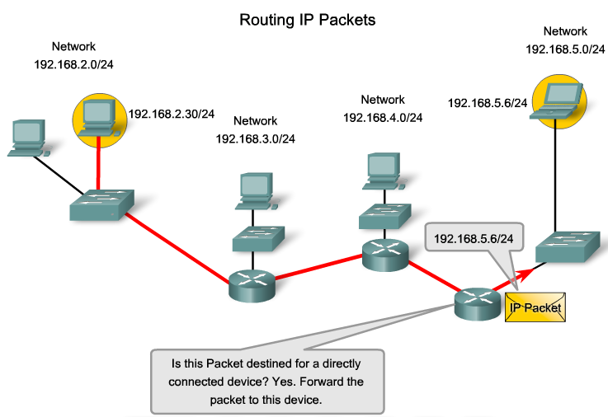
Fundamentals of Routes, Next Hop Addresses and Packet Forwarding

Slide 26
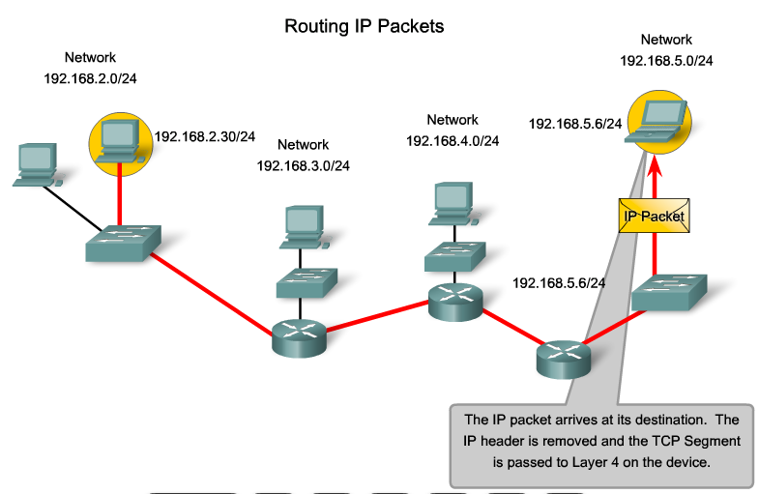
Fundamentals of Routes, Next Hop Addresses and Packet Forwarding

Slide 27
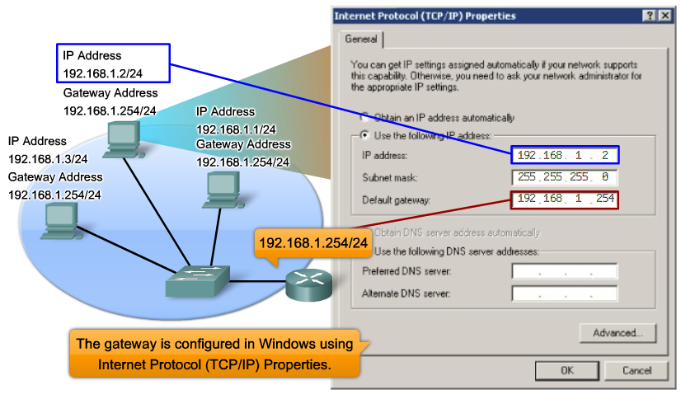
Configuring the IP address & default gateway

Slide 28
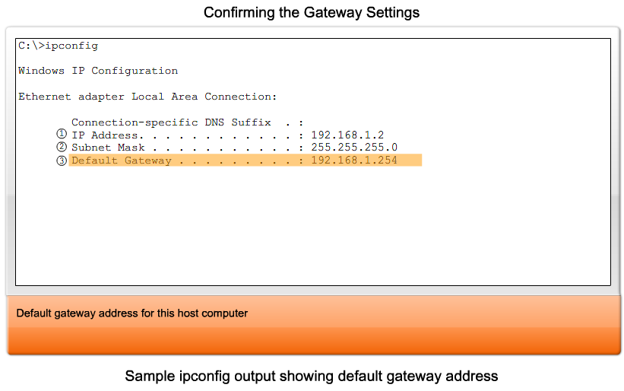
Configuring the IP address & default gateway

Slide 29
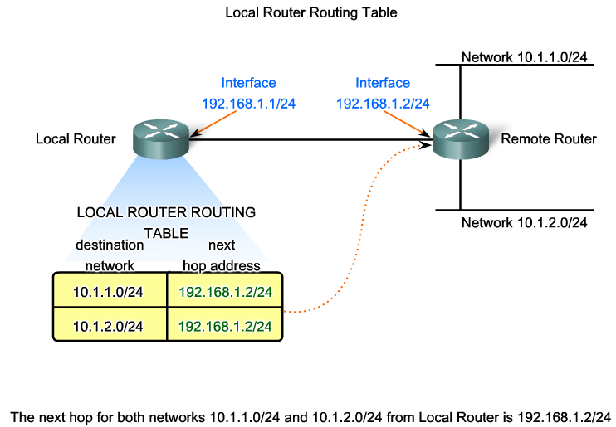
Fundamentals of Routes, Next Hop Addresses and Packet Forwarding

Slide 30
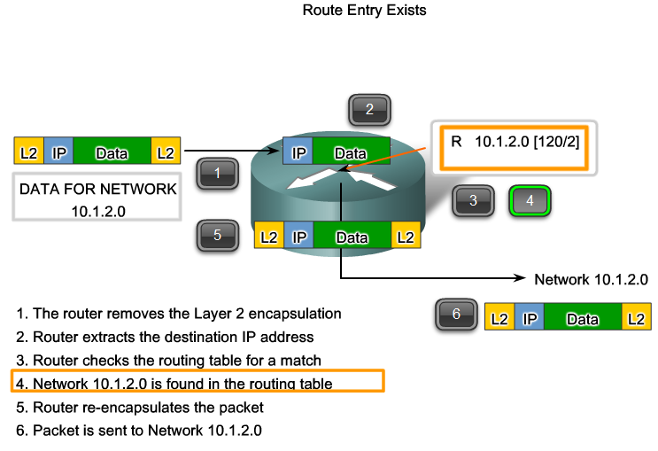
Fundamentals of Routes, Next Hop Addresses and Packet Forwarding

Slide 31
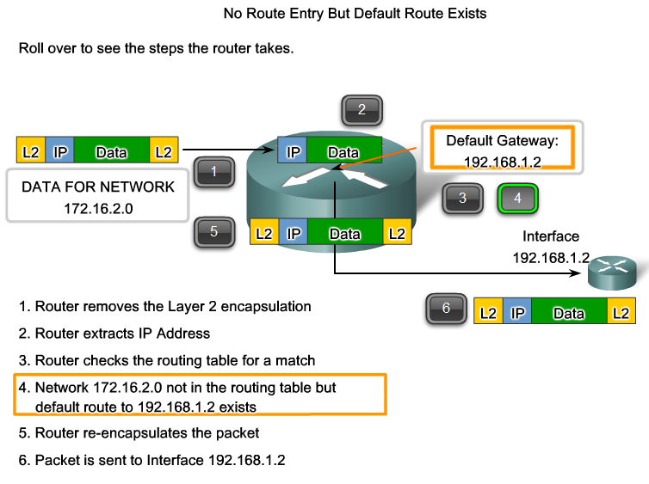
Fundamentals of Routes, Next Hop Addresses and Packet Forwarding

Slide 32
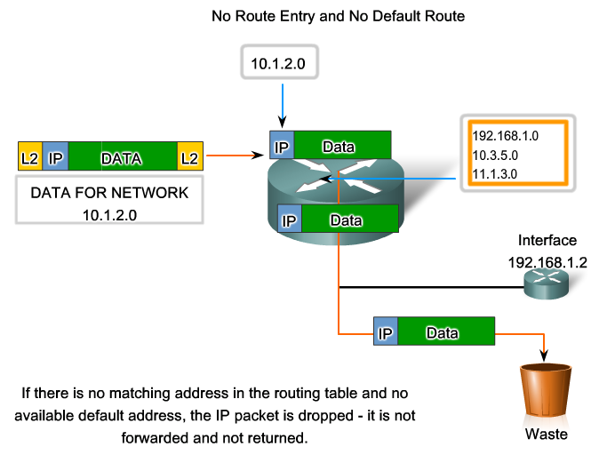
Fundamentals of Routes, Next Hop Addresses and Packet Forwarding

Slide 33
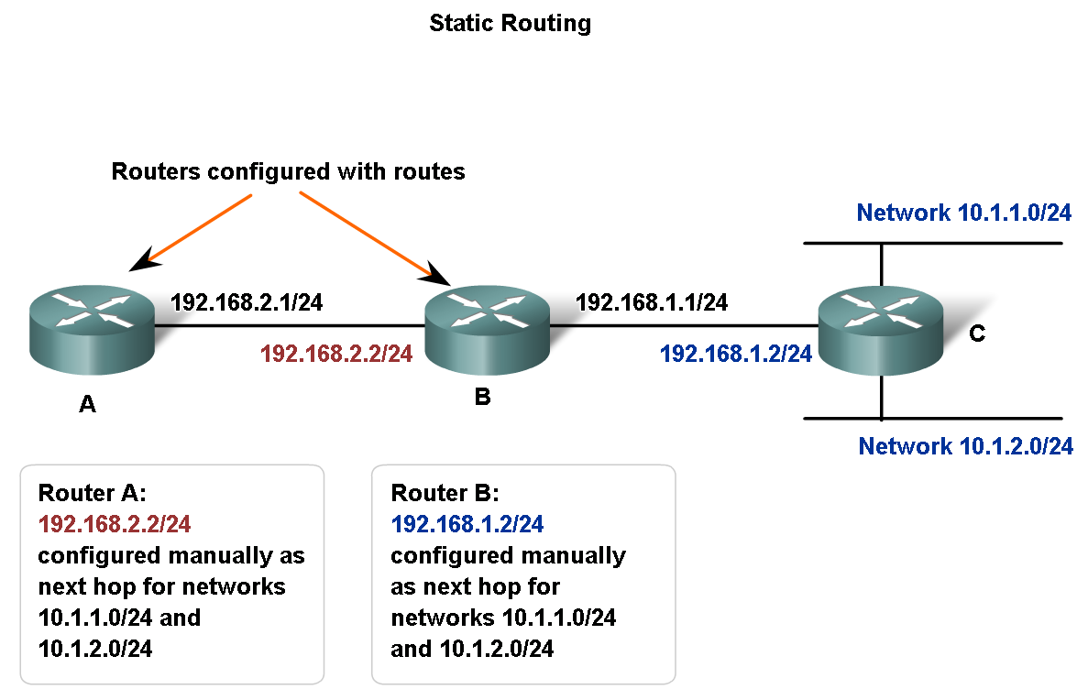
Fundamentals of Routes, Next Hop Addresses and Packet Forwarding

Slide 34
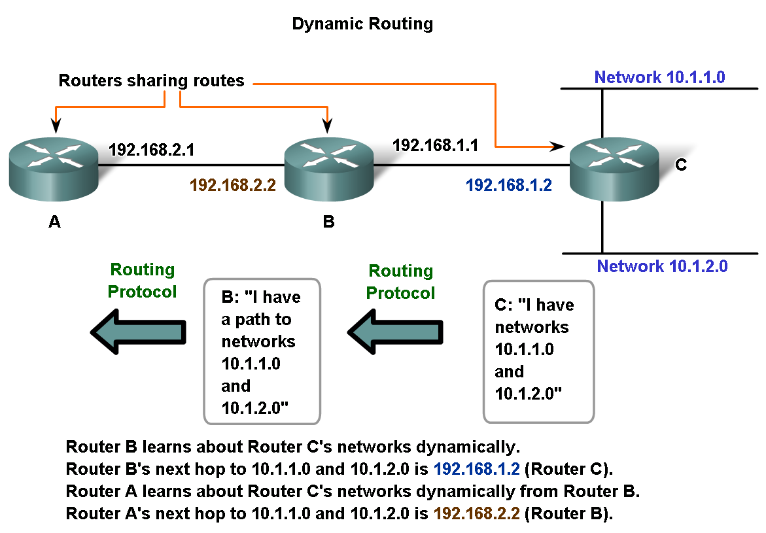
Fundamentals of Routes, Next Hop Addresses and Packet Forwarding

Slide 36
Addressing the Network – IPv4

Slide 37
Objectives
Explain the structure IP addressing and demonstrate the ability to convert between 8-bit binary and decimal numbers.
Given an IPv4 address, classify by type and describe how it is used in the network
Explain how addresses are assigned to networks by ISPs and within networks by administrators
Determine the network portion of the host address and explain the role of the subnet mask in dividing networks.
Given IPv4 addressing information and design criteria, calculate the appropriate addressing components.
Use common testing utilities to verify and test network connectivity and operational status of the IP protocol stack on a host.

Slide 38
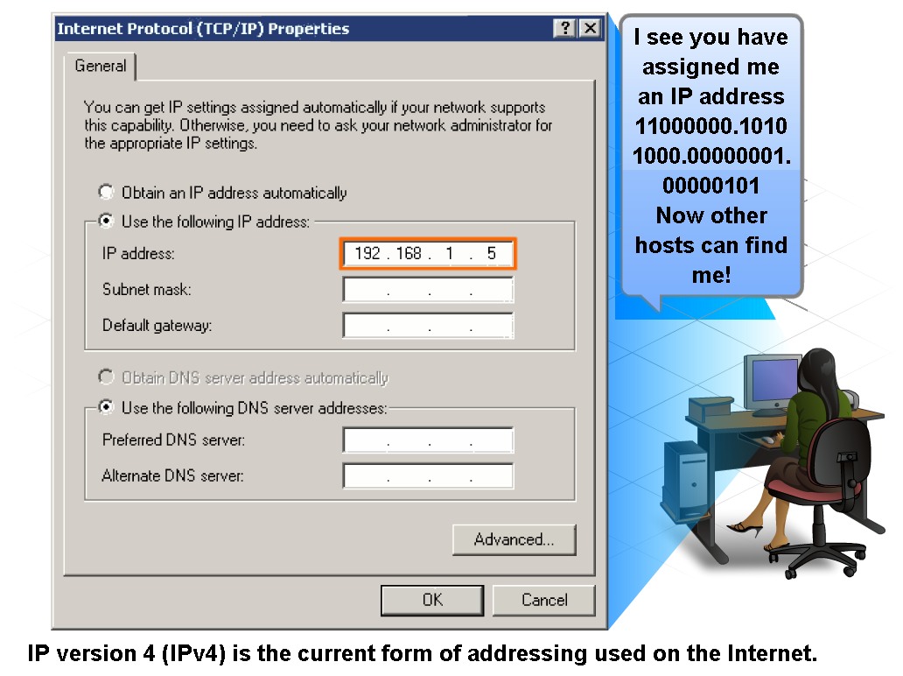
IP Addressing Structure

Slide 39
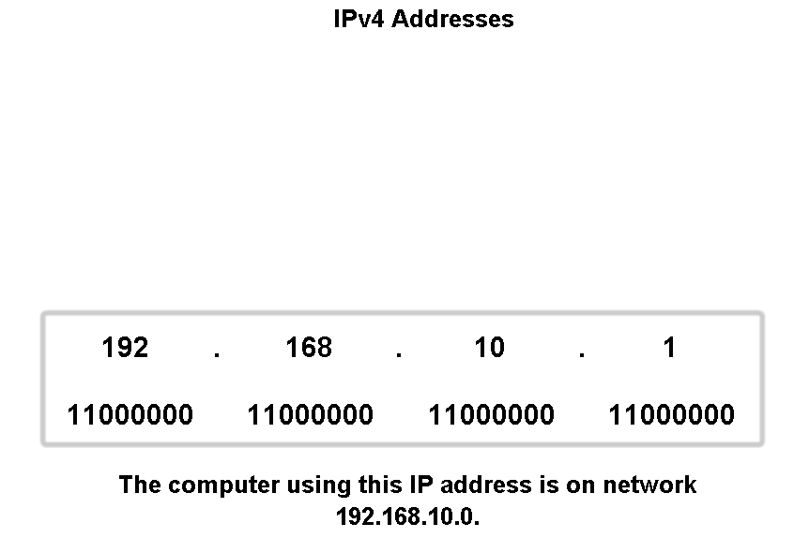
IP Addressing Structure

Slide 40
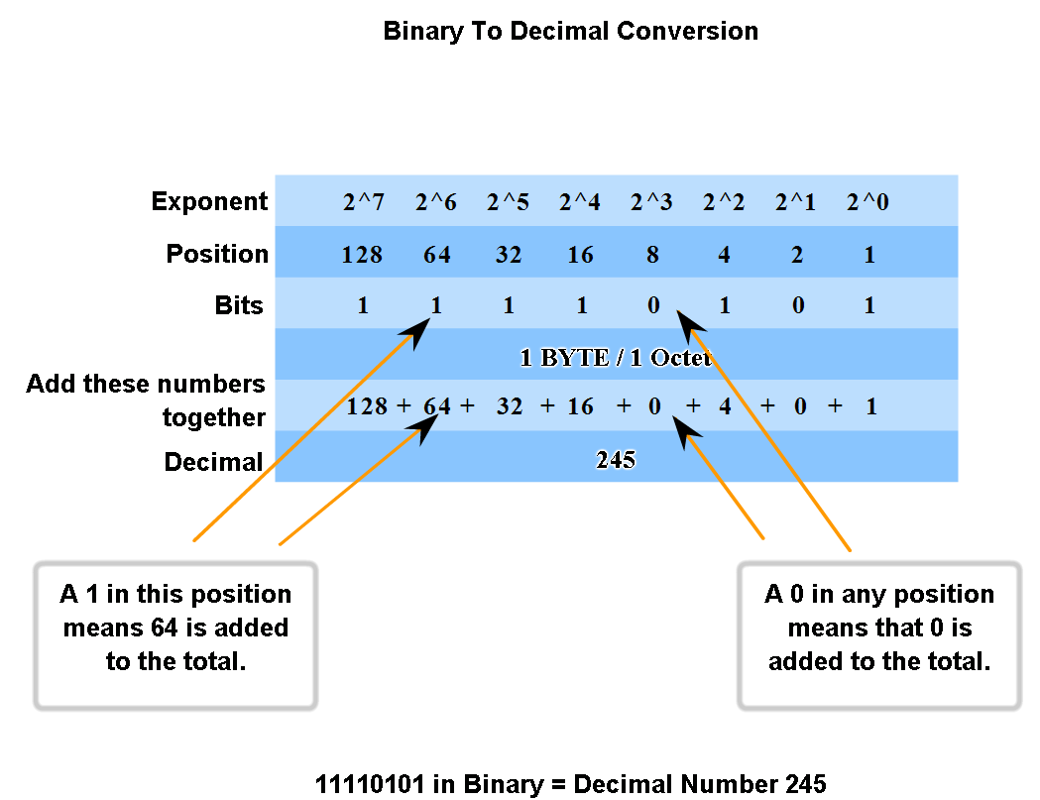
Binary & Decimal Numbering System

Slide 41
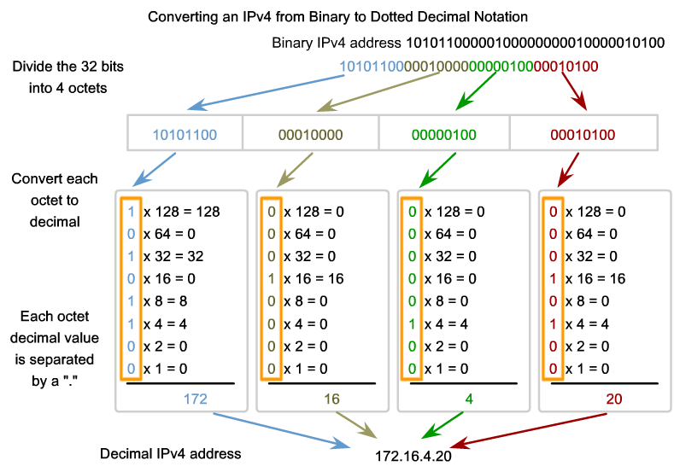
Binary & Decimal Numbering System

Slide 42
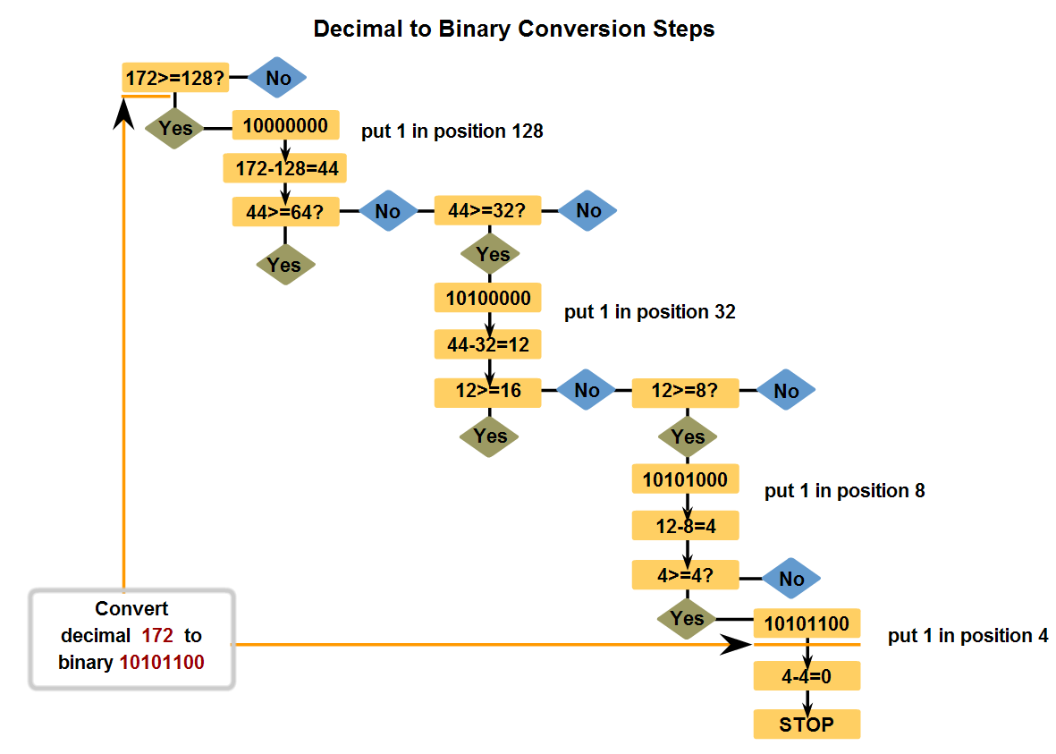
Binary & Decimal Numbering System

Slide 43
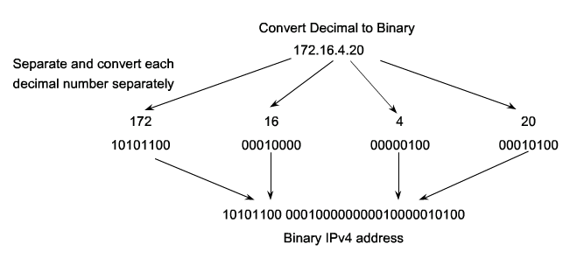
Binary & Decimal Numbering System

Slide 44
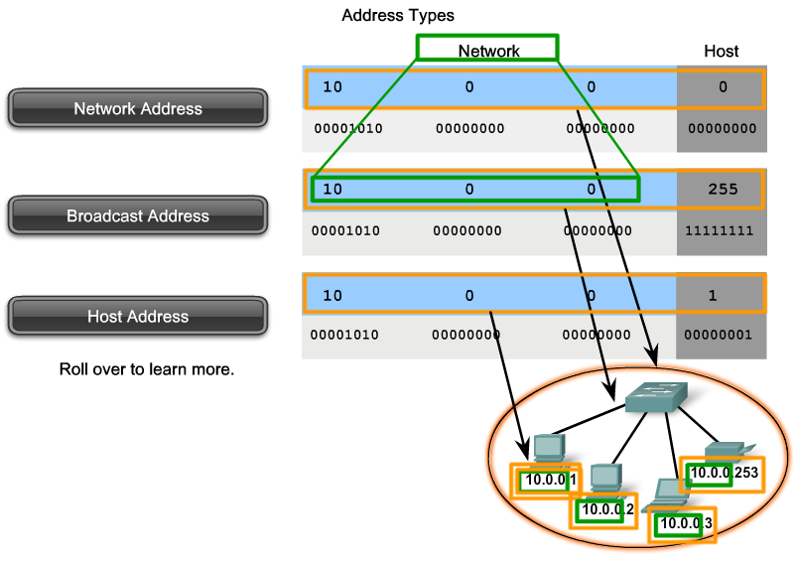
Classify and Define IPv4 Addresses

Slide 45
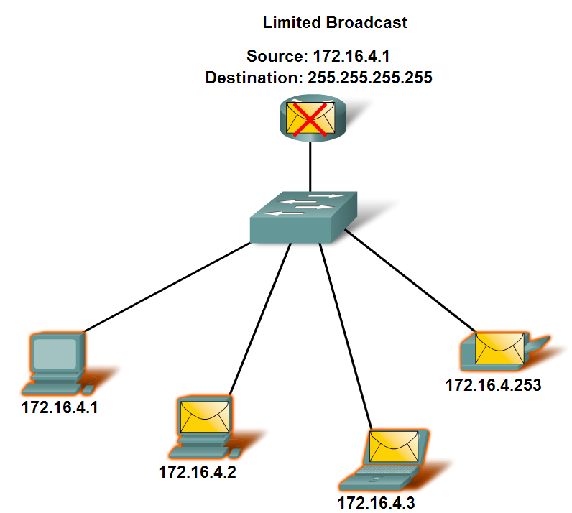
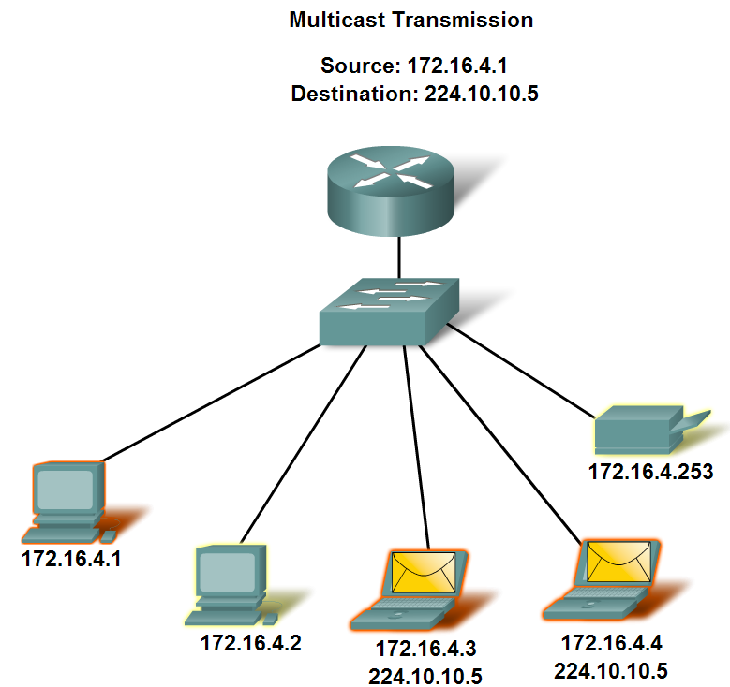
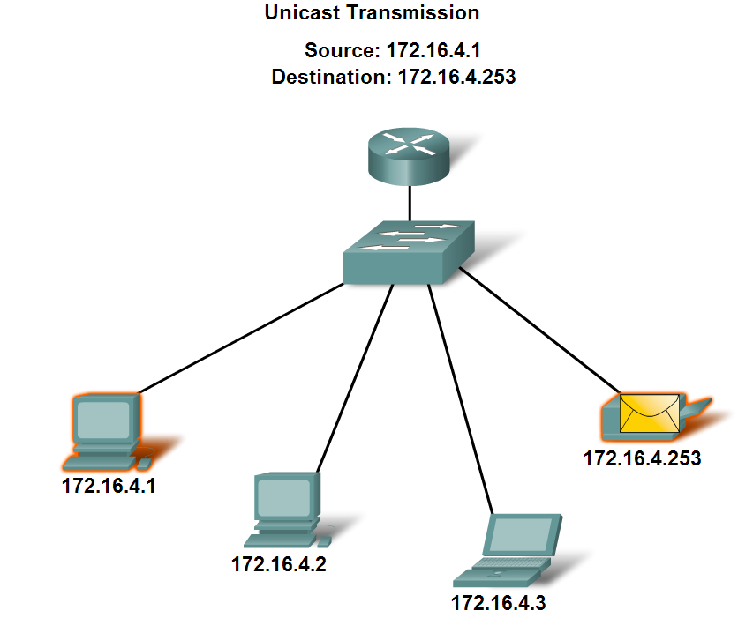
Classify and Define IPv4 Addresses

Slide 46
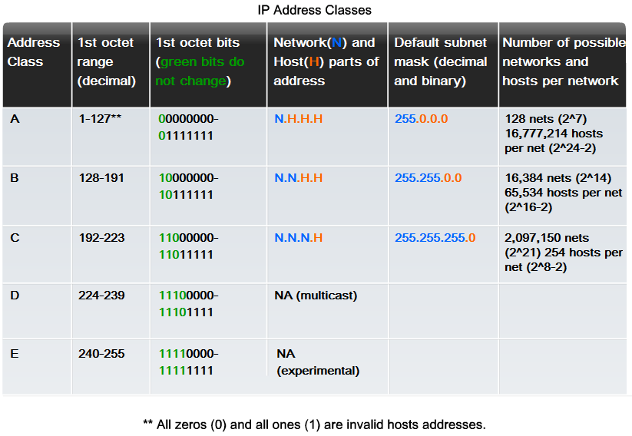
IP address Classes

Slide 47
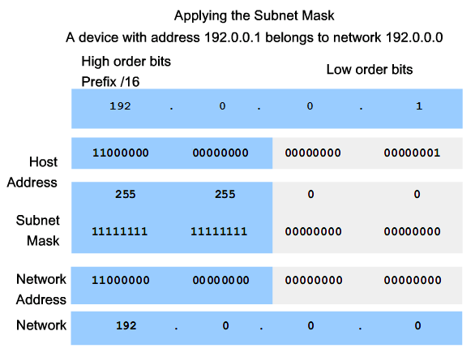
Subnet mask

Slide 48
Private Addresses
These private IP addresses are for intra-network use only and can not be routed across the Internet.
These private addresses are
  Class A → 10.0.0.0/8 to 10.255.255.255/8
  Class B → 172.16.0.0/16 to 172.31.255.255/16
  Class C → 192.168.0.0/24 to 192.168.255.255/24

Slide 49
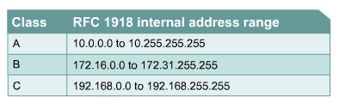
Private IP Addresses
Private IP addresses are another solution to the problem of the impending exhaustion of public IP addresses.As mentioned, public networks require hosts to have unique IP addresses.
However, private networks that are not connected to the Internet may use any host addresses, as long as each host within the private network is unique.

Slide 50
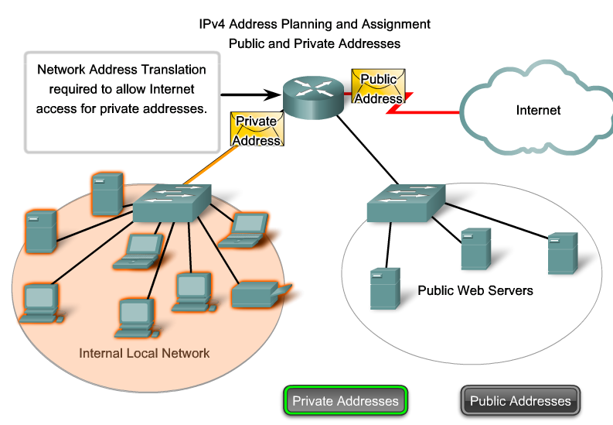
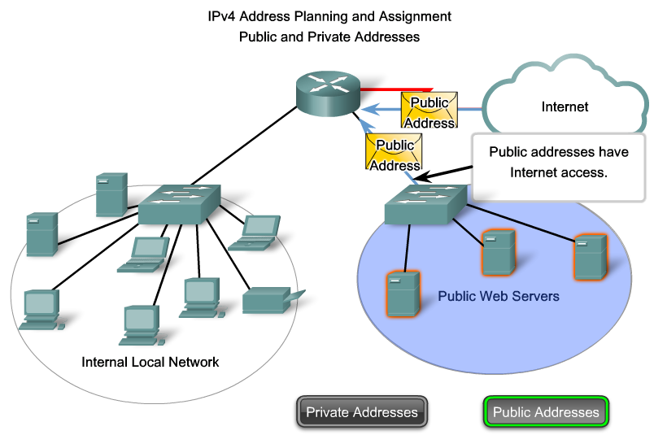
Private IP Addresses

Slide 51
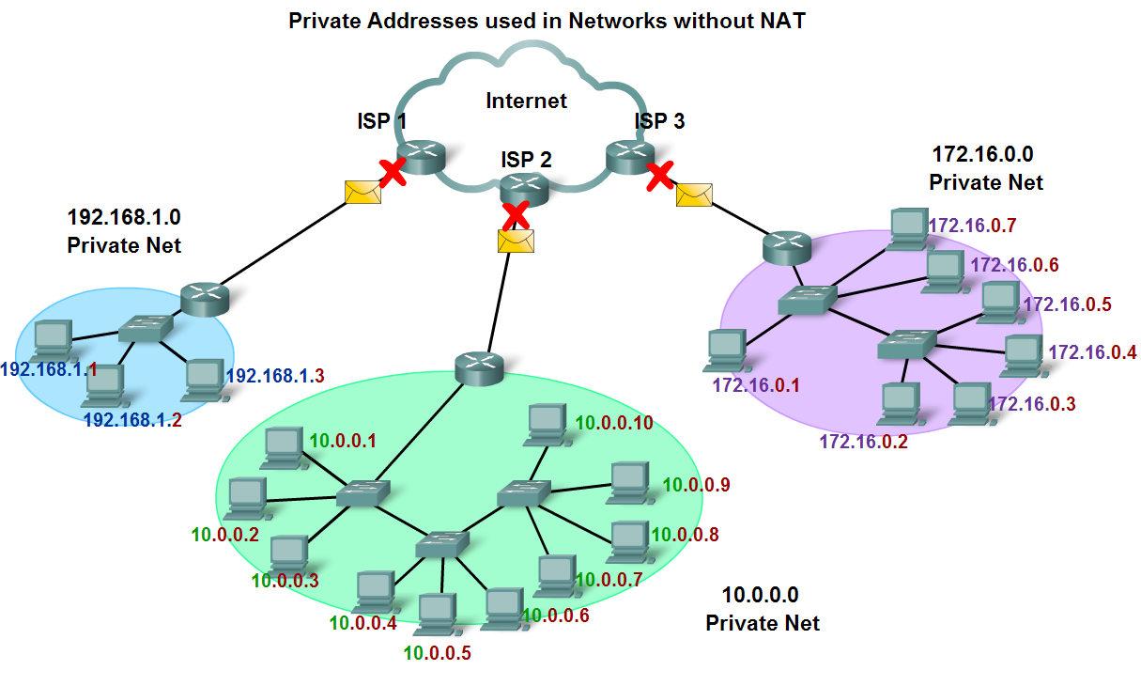
Classify and Define IPv4 Addresses

